Slide 1
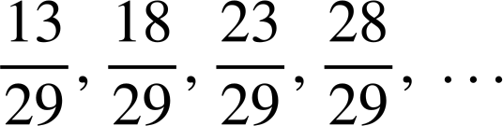
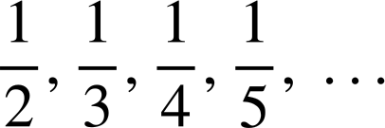
Checking understanding of arithmetic sequences
Checking understanding of arithmetic sequences
Task A: Identifying arithmetic sequences
1) Label these sequences as ‘arithmetic’ or ‘not arithmetic’.
a) 9, 13, 17, 21, 25, …
b) 37, 31, 25, 19, 13, …
c) −70, −68, −66, −64, −62, …
d) 35, 31, 26, 20, 13, …
e) 12.6, 13.7, 14.8, 15.9 …
f) 3, 6, 12, 24, 48, …
g)
h)
Task B: Checking understanding of arithmetic sequences
1) Find the first five terms of these three sequences:
a) 3n + 7
b) 3n − 7
Term number (n) | 1 | 2 | 3 | 4 | 5
Term (T)
Term number (n) | 1 | 2 | 3 | 4 | 5
Term (T)
c) 0.3n + 7
d) 7 − 3n
Term number (n) | 1 | 2 | 3 | 4 | 5
Term (T)
Term number (n) | 1 | 2 | 3 | 4 | 5
Term (T)

Slide 2
Checking understanding of arithmetic sequences
2) Find the 10th, 50th, and 100th terms of these sequences.
a) 9n + 6
b) 9n − 6
c) 0.9n + 0.6
d) 6 − 9n

Slide 3
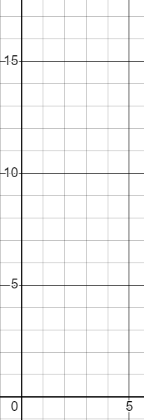
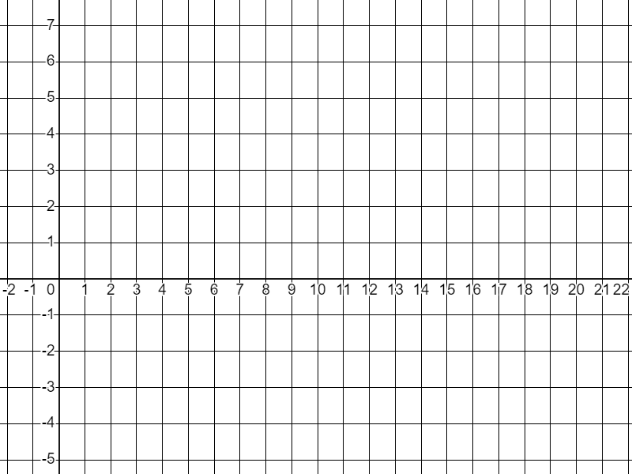
Checking understanding of arithmetic sequences
Task C: Representations of arithmetic sequences
1) Draw a visual representation for the first five terms of these sequences:
a) 5, 7, 9, 11,13, …
b) 13,10, 7, 4, 1
c) 5n + 1
2) Plot the first five terms of these sequences:
a) 4n − 3
b) 10 − 3n
n | 1 | 2 | 3 | 4 | 5
T
n | 1 | 2 | 3 | 4 | 5
T
T
T
n
n
Mathematics in Education and Industry.
v2.3

